Slide 1
Automated Web Testing with Selenium and WebDriver Using Java
Getting Started with Selenium

Slide 2
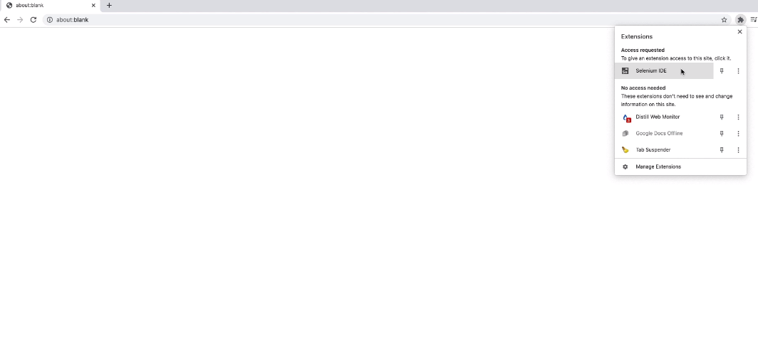

Slide 3
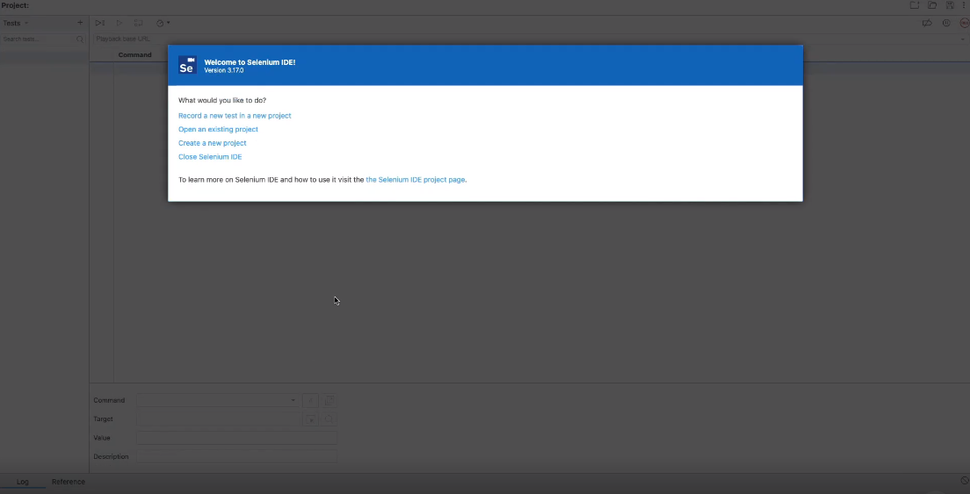

Slide 4
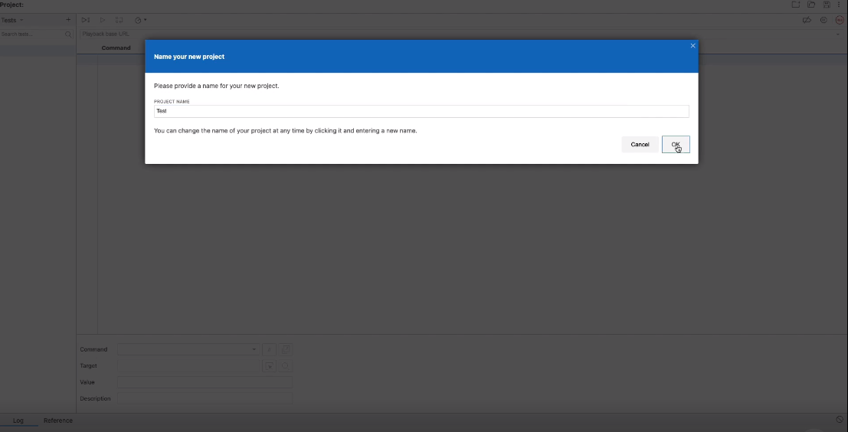

Slide 5
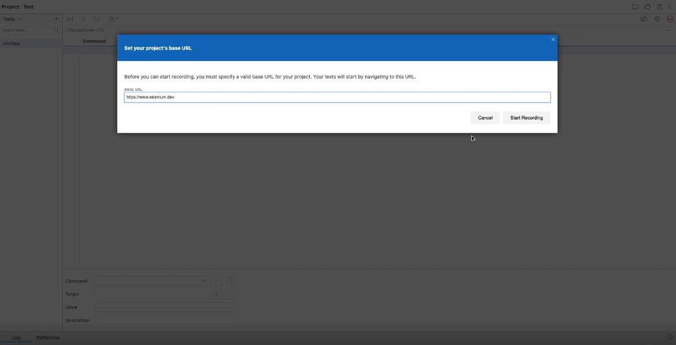

Slide 7
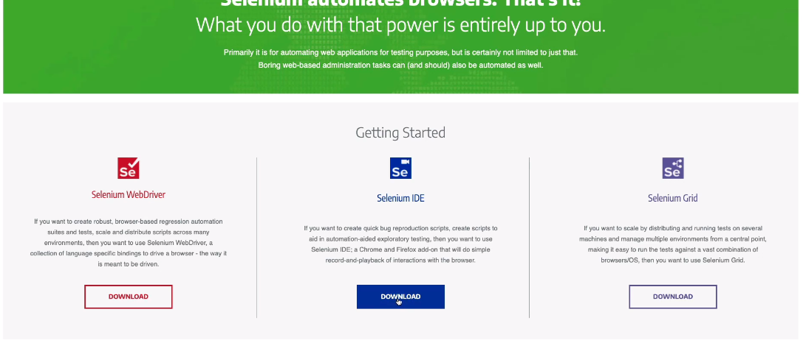

Slide 10
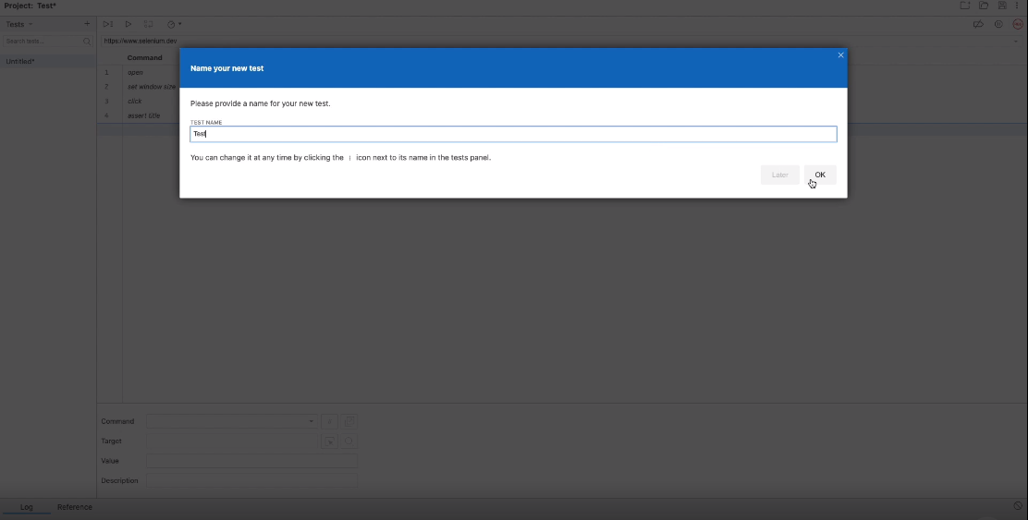

Slide 11
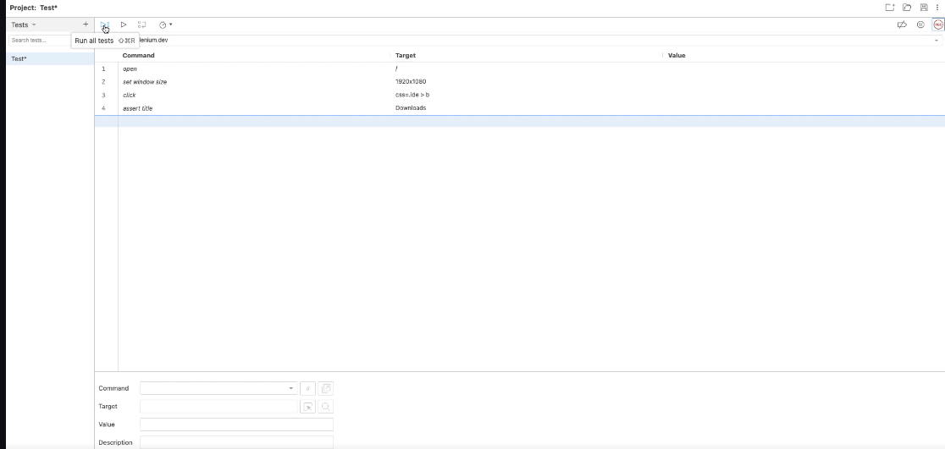

Slide 12
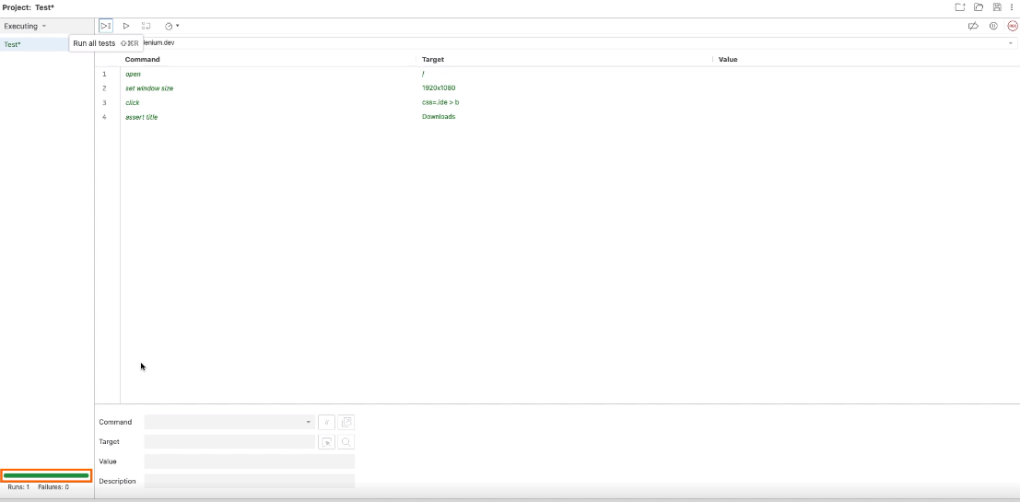

Slide 13
Selenium and WebDriver
Selenium
Uses WebDriver, Selenium IDE, Selenese
WebDriver
API, Java, .Net, Python

Slide 15
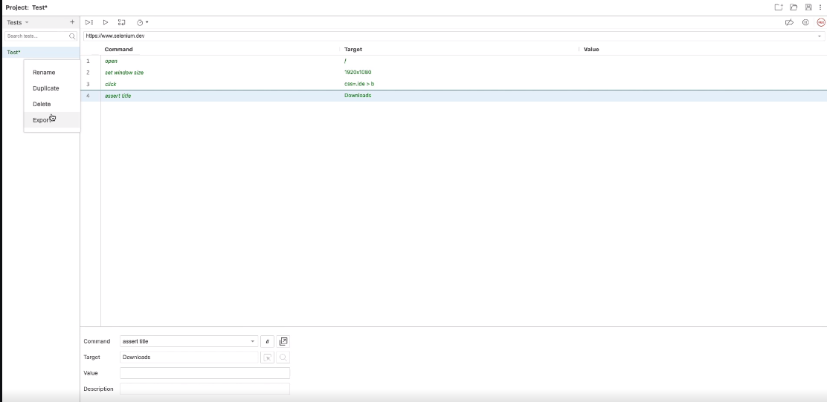

Slide 16
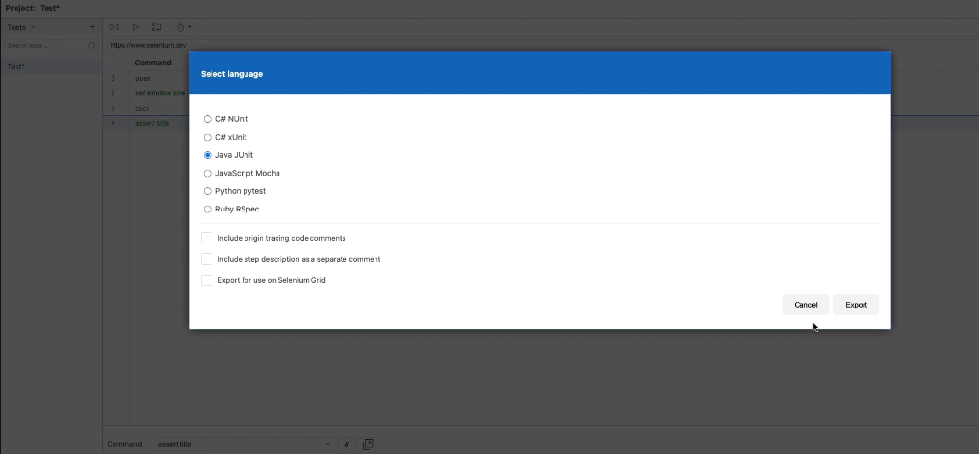

Slide 18

Automated Testing

Slide 19

Concurrent Development

Slide 20

End User

Slide 21

Interpreted

Slide 22
Python
Java
C#
Ruby
WebDriver API
Chrome
Firefox
IE
HtmlUnit

Slide 23

Summary
Selenium IDE WebDriver Why?
Architecture

